Slide 1
ORACLE SQL Introduction
MTN.NIX.07
ORACLE SQL BASICS,
THE SELECT STATEMENT
Siarhei Kandrashevich
Senior DB Developer

Slide 2
Objectives
Aggregate Functions (Having clause)
Joining tables

Slide 3
Aggregate Functions (Having clause)

Slide 4
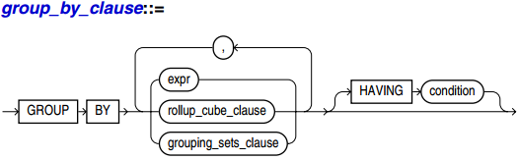
Having clause
Use the HAVING clause to restrict the groups of returned rows to those groups for which the specified condition is TRUE.

Slide 5
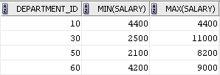
Having clause: Example
SELECT department_id, MIN(salary), MAX(salary)
FROM employees
GROUP BY department_id
HAVING MIN(salary) < 5000
ORDER BY department_id;

Slide 6
Join Tables
Notes:
The goal is compare ANSI joins in FROM clause and Oracle-specific joins with (+) construction.
ANSI - Oracle
Oracle fully supports these features
F041, Basic joined table
F401, Extended joined table (FULL outer joins, CROSS joins, and NATURAL joins).
Oracle has own mechanism to specify outer joins in WHERE clause “(+)”.
ANSI joins:
<joined table> ::=
<cross join>
| <qualified join>
| <natural join>
<cross join> ::=
<table reference> CROSS JOIN <table factor>
<qualified join> ::=
{ <table reference>| <partitioned join table>}
[ <join type>] JOIN
{ <table reference>| <partitioned join table>}
<join specification>
<partitioned join table> ::=
<table factor> PARTITION BY
<partitioned join column reference list>
<partitioned join column reference list> ::=
<left paren> <partitioned join column reference>
[ { <comma> <partitioned join column reference>}... ]
<right paren>
<partitioned join column reference> ::=
<column reference>
<natural join> ::=
{ <table reference>| <partitioned join table>}
NATURAL[ <join type>] JOIN
{ <table factor>| <partitioned join table>}
<join specification> ::=
<join condition>
| <named columns join>
<join condition> ::=
ON <search condition>
<named columns join> ::=
USING <left paren> <join column list> <right paren>
<join type> ::=
INNER
| <outer join type>[ OUTER]
<outer join type> ::=
LEFT
| RIGHT
| FULL
<join column list> ::=
<column name list>

Slide 7
SQL Joins Classification
Inner join
Equi-join
Natural join
Outer joins
Left outer join
Right outer join
Full outer join
Cross join
Self-join
Qualified joins
Notes:
SQL joins come in two main types: unqualified and qualified.
Cross join is Cartesian Product of all records in both datasets.
Self-join can be any type above (even cross).

Slide 8
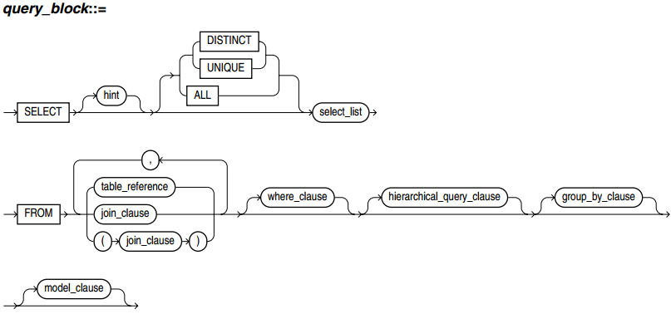
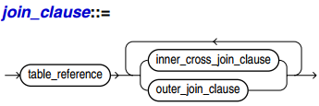
Join Syntax
Notes:
Join Clause
(Simplified: without partitioning, full specification in [1], see join_clause p.1463)
Use the appropriate syntax (INNER / OUTER/ CROSS / NATURAL JOIN) to identify tables that are part of a join from which to select data.
When you join more than two row sources, you can use parentheses to override default precedence. For example, the following syntax:
SELECT ... FROM a JOIN (b JOIN c) ...
results in a join of b and c, and then a join of that result set with a.
INNER JOIN
Inner joins return only those rows that satisfy the join condition. Specify INNER to explicitly specify an inner join. The JOIN keyword explicitly states that a join is being performed. You can use this syntax to replace the comma-delimited table expressions used in WHERE clause joins with FROM clause join syntax.
Use the ON clause to specify a join condition. Doing so lets you specify join conditions separate from any search or filter conditions in the WHERE clause.
When you are specifying an equijoin of columns that have the same name in both tables, the USING column clause indicates the columns to be used. You can use this clause only if the join columns in both tables have the same name. Within this clause, do not qualify the column name with a table name or table alias.
NATURAL JOIN
The NATURAL keyword indicates that a natural join is being performed. A natural join is based on all columns in the two tables that have the same name. It selects rows from the two tables that have equal values in the relevant columns. If two columns with the same name do not have compatible data types, then an error is raised. When specifying columns that are involved in the natural join, do not qualify the column name with a table name or table alias.
On occasion, the table pairings in natural or cross joins may be ambiguous. For example, consider the following join syntax:
a NATURAL LEFT JOIN b LEFT JOIN c ON b.c1 = c.c1
This example can be interpreted in either of the following ways:
a NATURAL LEFT JOIN (b LEFT JOIN c ON b.c1 = c.c1)
(a NATURAL LEFT JOIN b) LEFT JOIN c ON b.c1 = c.c1
To avoid this ambiguity, you can use parentheses to specify the pairings of joined tables. In the absence of such parentheses, the database uses left associativity, pairing the tables from left to right.
CROSS JOIN
The CROSS keyword indicates that a cross join is being performed. A cross join produces the cross-product of two relations and is essentially the same as the comma-delimited Oracle Database notation.
OUTER JOINS
Outer joins return all rows that satisfy the join condition and also returns some or all of those rows from one table for which no rows from the other satisfy the join condition.
Specify RIGHT to indicate a right outer join. Specify LEFT to indicate a left outer join. Specify FULL to indicate a full or two-sided outer join. In addition to the inner join, rows from both tables that have not been returned in the result of the inner join will be preserved and extended with nulls.

Slide 9
SQL Joins
INNER JOIN
Query 1
Query 2
An inner join (sometimes called a simple join) is a join of two or more tables that returns only those rows that satisfy the join condition.

Slide 10
SQL Joins
LEFT OUTER JOIN
RIGHT OUTER JOIN
Query 1
Query 2
Query 1
Query 2
FULL OUTER JOIN
Query 1
Query 2
An outer join extends the result of a simple join. An outer join returns all rows that satisfy the join condition and also returns some or all of those rows from one table for which no rows from the other satisfy the join condition.

Slide 11
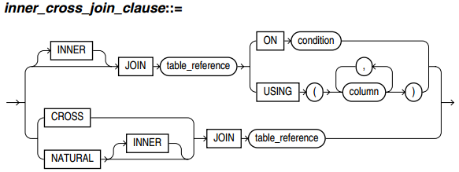
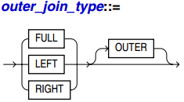
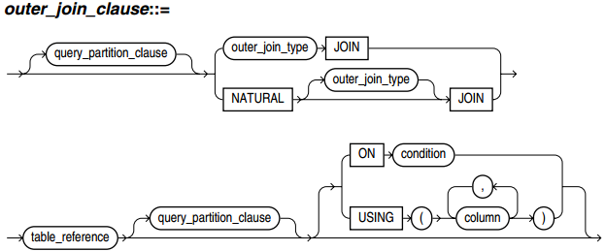
Inner / Outer / Cross Joins Syntax
Notes:
Oracle fully supports ANSI join syntax.
Simplified: without query_partition_clause
The query_partition_clauselets you define a partitioned outer join. Such a join extends the conventional outer join syntax by applying the outer join to partitions returned by the query.

Slide 12
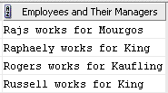
Using Self Joins: Example
The following query uses a self join to return the name of each employee along with the name of the employee's manager.
SELECT e1.last_name||' works for '||e2.last_name
"Employees and Their Managers"
FROM employees e1, employees e2
WHERE e1.manager_id = e2.employee_id
AND e1.last_name LIKE 'R%'
ORDER BY e1.last_name;

Slide 13
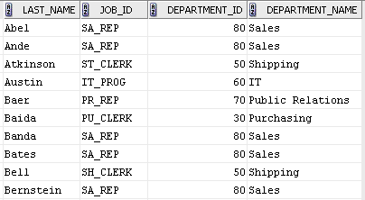
Using Join Queries: Examples
The following examples show various ways of joining tables in a query.
SELECT last_name, job_id, departments.department_id, department_name
FROM employees, departments
WHERE employees.department_id = departments.department_id
ORDER BY last_name, job_id;

Slide 14
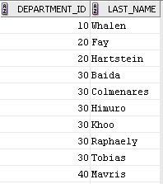
Using Outer Joins: Examples
The following example shows how a partitioned outer join fills data gaps in rows to facilitate analytic function specification and reliable report formatting.
SELECT d.department_id, e.last_name
FROM departments d
LEFT OUTER JOIN employees e ON d.department_id=e.department_id
ORDER BY d.department_id, e.last_name;

Slide 15
Using Outer Joins: Examples
Users familiar with the traditional Oracle Database outer joins syntax will recognize the same query in this form:
SELECT d.department_id, e.last_name
FROM departments d, employees e
WHERE d.department_id = e.department_id(+)
ORDER BY d.department_id, e.last_name;

Slide 16
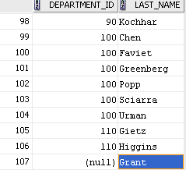
Using Outer Joins: Examples
The left outer join returns all departments, including those without any employees. The same statement with a right outer join returns all employees, including those not yet assigned to a department:
SELECT d.department_id, e.last_name
FROM departments d RIGHT OUTER JOIN employees e
ON d.department_id = e.department_id
ORDER BY d.department_id, e.last_name;

Slide 17
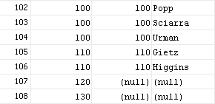
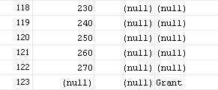
Using Outer Joins: Examples
It is not clear from this result whether employees Grant has department_id NULL, or whether their department_id is not in the departmentstable.
SELECT d.department_id as d_dept_id,
e.department_id as e_dept_id, e.last_name
FROM departments d FULL OUTER JOIN employees e
ON d.department_id = e.department_id
ORDER BY d.department_id, e.last_name;
…

Slide 18
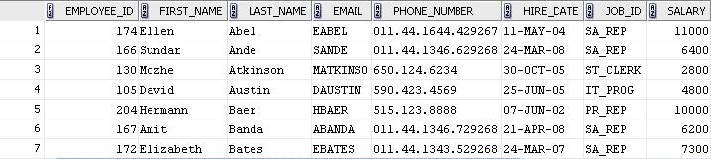
Using Antijoins: Example
The following example selects a list of employees who are not in a particular set of departments:
SELECT * FROM employees
WHERE department_id NOT IN
(SELECT department_id FROM departments
WHERE location_id = 1700)
ORDER BY last_name;

Slide 19
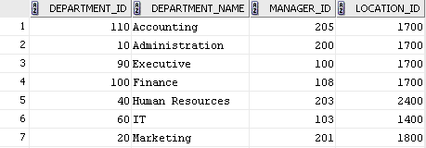
Using Semijoins: Example
In the following example, only one row needs to be returned from the departments table, even though many rows in theemployees table might match the subquery.
SELECT * FROM departments
WHERE EXISTS
SELECT * FROM employees
WHERE departments.department_id = employees.department_id
AND employees.salary > 2500)
ORDER BY department_name;

Slide 20
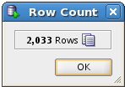
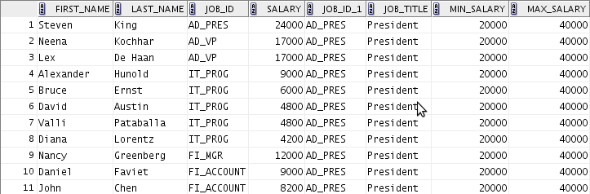
Simple Join Example (cross join Employees and Jobs)
SELECT emp.first_name, emp.last_name,
emp.job_id, emp.salary, jb.*
FROM employees emp, jobs jb;
SELECT emp.first_name, emp.last_name,
emp.job_id, emp.salary, jb.*
FROM employees emp CROSS JOIN jobs jb;
Notes:
Cross join Employees and Jobs absolutely senseless.
But, result of any other join operation is subset of Cartesian Product (which is cross join) – we just need to clarify how to reduce tables Cartesian Product to get desired result.
Both queries produce the same result set.
Both syntax are standard.
First query looks like a mistake (user forgot WHERE clause, but second is ok – it says “I understand what I do”)
-- Cross join or Cartesian Product
SELECT emp.first_name, emp.last_name,
emp.job_id, emp.salary, jb.*
FROM employees emp, jobs jb;
SELECT emp.first_name, emp.last_name,
emp.job_id, emp.salary, jb.*
FROM employees emp CROSS JOIN jobs jb;

Slide 21

Prove Cross Join
SELECT count(*) AS cnt
FROM employees emp, jobs jb;
SELECT count(*) AS cnt
FROM employees emp CROSS JOIN jobs jb;
SELECT
(SELECT count(*) FROM employees emp)
* (SELECT count(*) FROM jobs jb) cnt
FROM dual;
Notes:
Employees – 107 records, jobs – 19
Dummy table DUAL is used is the last query.
It is required because by ANSI standard
<query specification> ::= SELECT[ <set quantifier>] <select list> <table expression>
The <table expression> is required (this is FROM clause). Oracle supports this standard and provide special dummy table DUAL.
For instance, MS SQL Server allows SELECT 1+1 construction, which will be SELECT 1+1 FROM dual in Oracle.
-- Prove Cross Join
SELECT count(*) AS cnt
FROM employees emp, jobs jb;
SELECT count(*) AS cnt
FROM employees emp CROSS JOIN jobs jb;
SELECT
(SELECT count(*) FROM employees emp)
* (SELECT count(*) FROM jobs jb) cnt
FROM dual;

Slide 22
ORACLE SQL INTODUCTION
MTN.NIX.07
Questions & Answers
Siarhei Kandrashevich
Senior DB Developer

